Slide 1


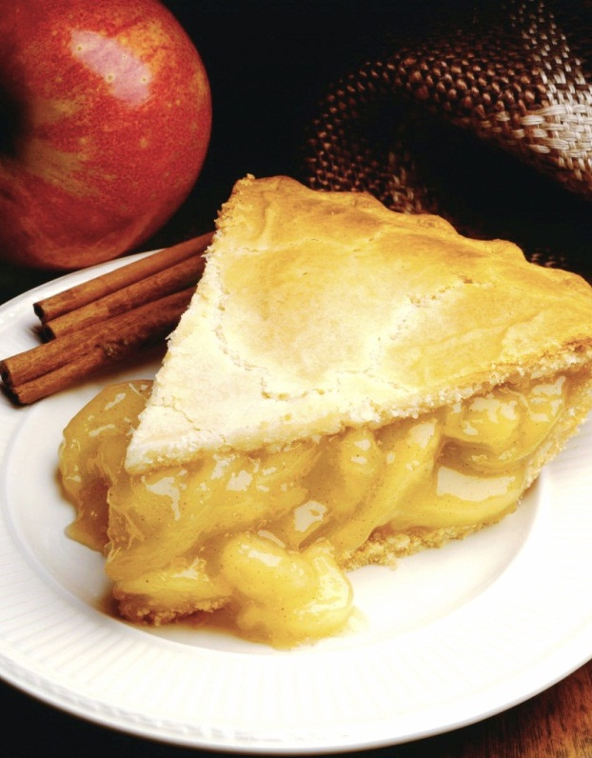
Head Over Meals
A Food Website
Notes:
NOTE: To replace a picture, just select and delete it. Then use the Insert Picture icon to replace it with one of your own!

Slide 2
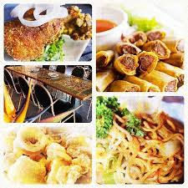
WELCOME TO HEAD OVER MEALS WEBSITE
BY- Muskan Srivastava
and Kushagra Dixit

Slide 3
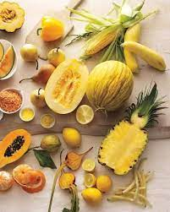
ABSTRACT
The Purpose of Online Food Ordering System is to automate the existing system by the help of Computerized equipment's and fully fledged computer software fulfilling their requirements so that their valuable data can be stored for a longer period with easy accessing and manipulation of the same.
Online Food Ordering System can lead to error free, secure, fast and reliable system. It can assist the user to focus on other activities rather to keep an eye on the record keeping.

Slide 4

INTRODUCTION
The Online Food Ordering System has been developed to override the problems prevailing in the practice manual system.
This software is supported to eliminate and, in some cases, reduce the hardships faced by the existing system. Moreover, this system is designed for the particular need of the company to carry out operations in a smooth and effective manner.
No formal knowledge is required by the user to use this system. It’s a user-friendly system. Online Food Ordering System can lead to error free, secure, fast and reliable system. It can assist the user to focus on other activities rather to keep an eye on the record keeping.
Thus, it will help the Organization in better utilization of resources. Every Organization whether big or small has challenges to overcome and managing the information of Item category, Food, Customer, Delivery Address, Order.

Slide 5
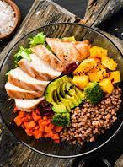
OBJECTIVE
The main Objective of the Project on Online Food Ordering System is to manage the details of food, Item Category, Shopping Cart, Customer, Order.
It manages all the Information about food, delivery address, order, Food.
The Project is totally built at administrative end and thus only the administrator can only access

Slide 6

MODULES OF THE PROJECT
Food Management Module: Used for managing the Food details.
Order Module: Used for managing the details of Order
Delivery Address Module: Used for managing the details of Delivery Address
Item Category Management Module: Used for managing the information and details of the Item Category.
Shopping Cart Module: Used for managing the Shopping Cart details
Customer Module: Used for managing the Customer information
Login Module: Used for managing the login details
Users Module: Used for managing the users of the

Slide 7
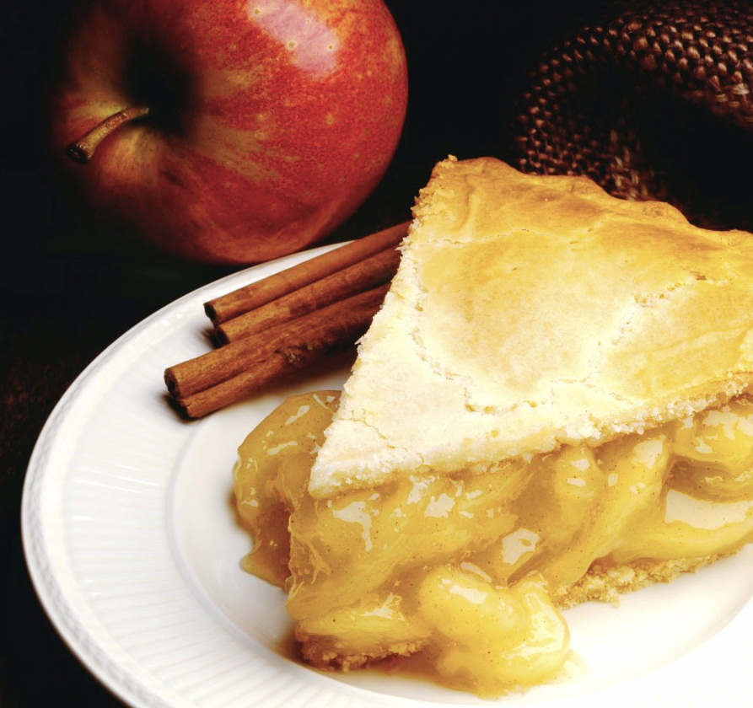
Picture with Caption Layout
Caption

Slide 8
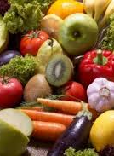
FEATURES OF THE SYSTEM
order product online
- upload product design online
- add, edit, delete product
- send order confirmation via email
- manage online order
- Ajax hierarchical combo box for payment method.
- add delivery charge outside the coverage area
- secure reservation
- forum for customer comments about the site
- generates various report
- and many more.

Slide 9
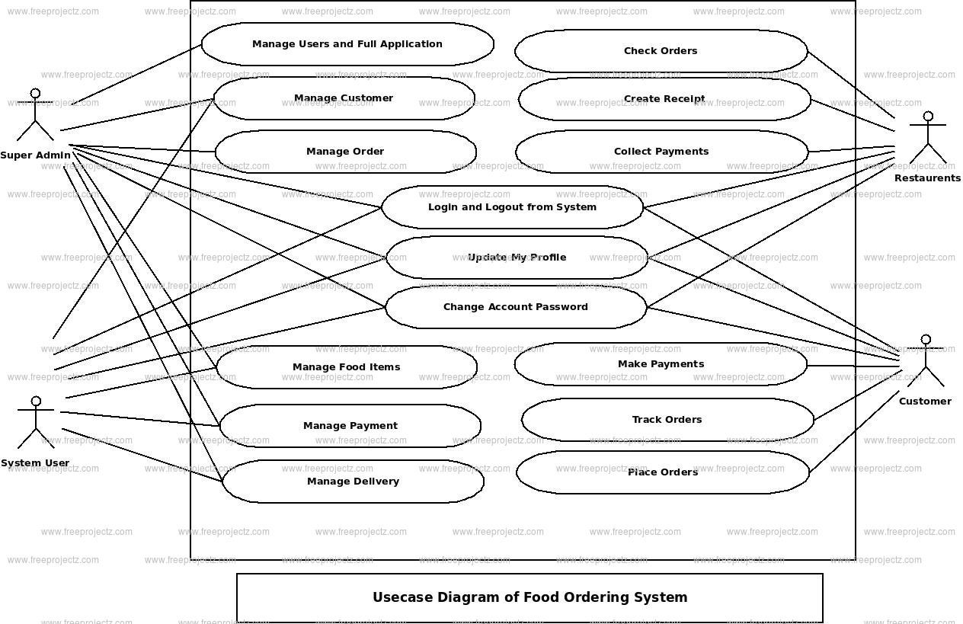
USE CASE DIGRAM

Slide 10
SNAPSHOTS OF THE PROJECT

Slide 11
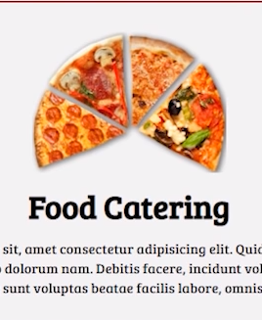
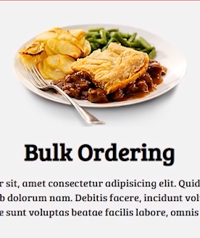
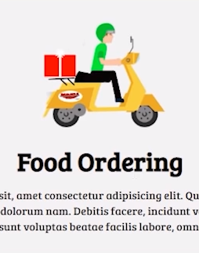
SERVICES PROVIDED

Slide 12
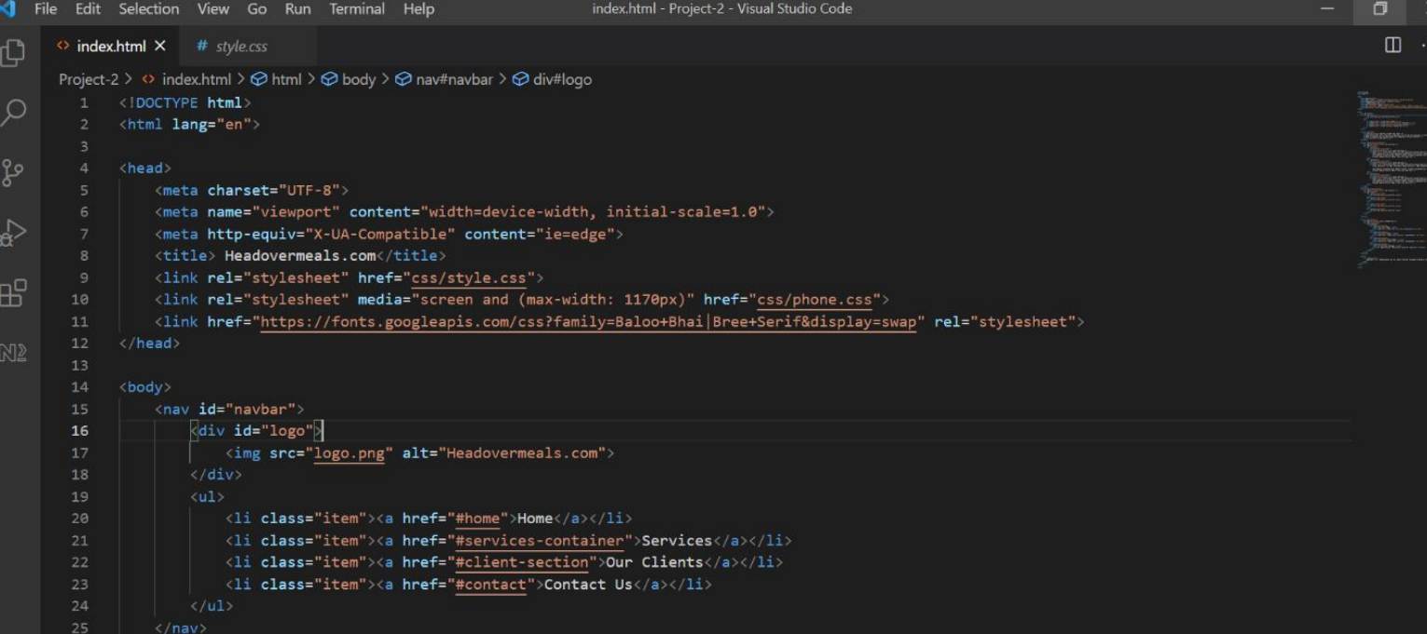

Slide 13
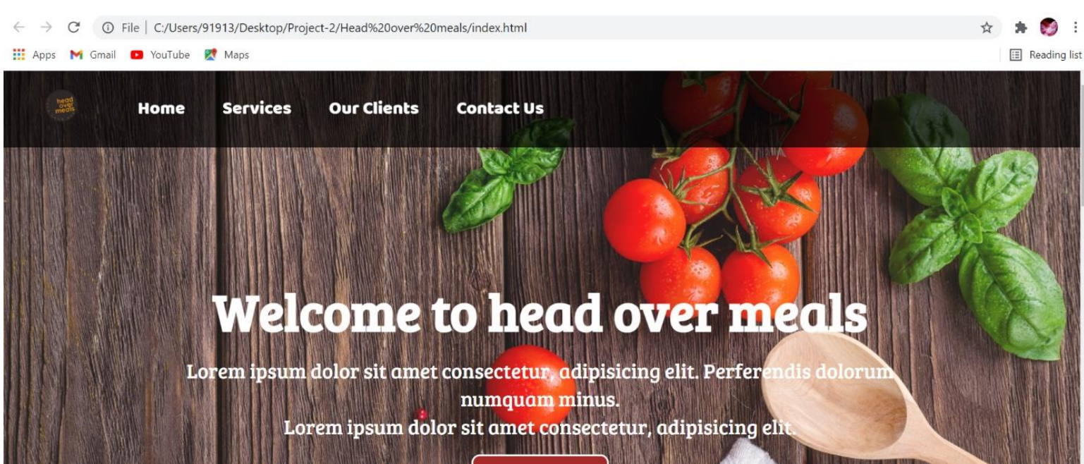

Slide 14
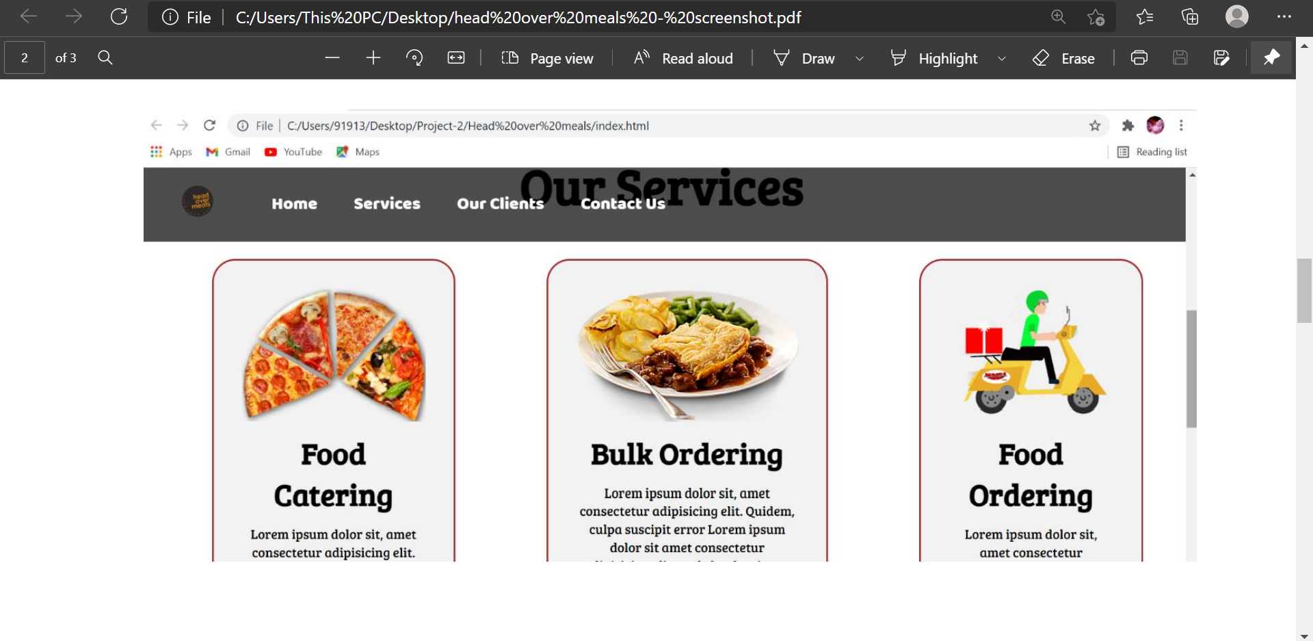

Slide 15
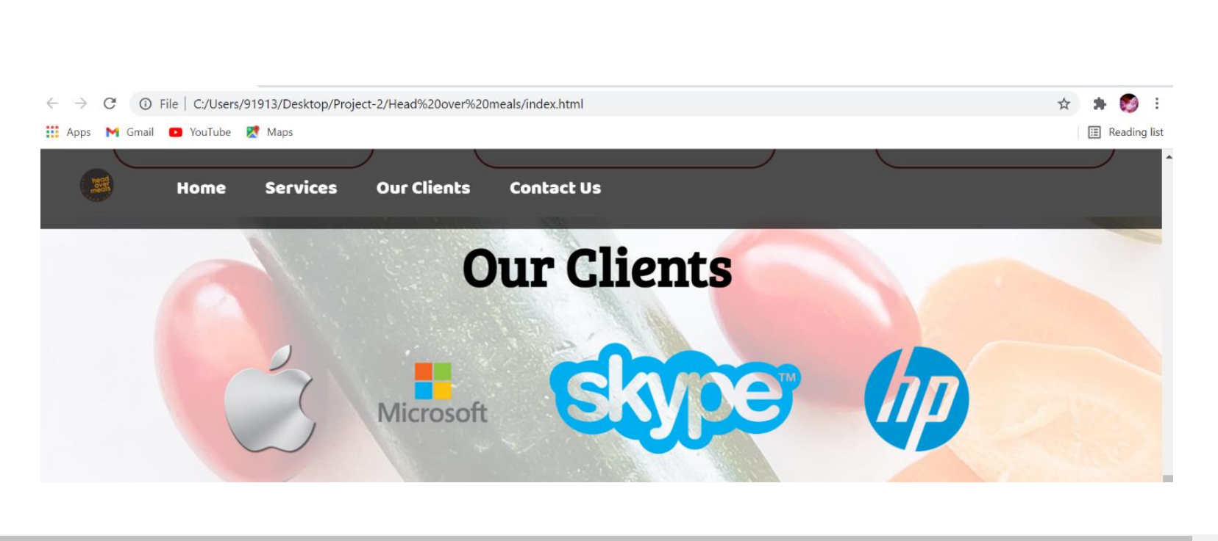

Slide 16
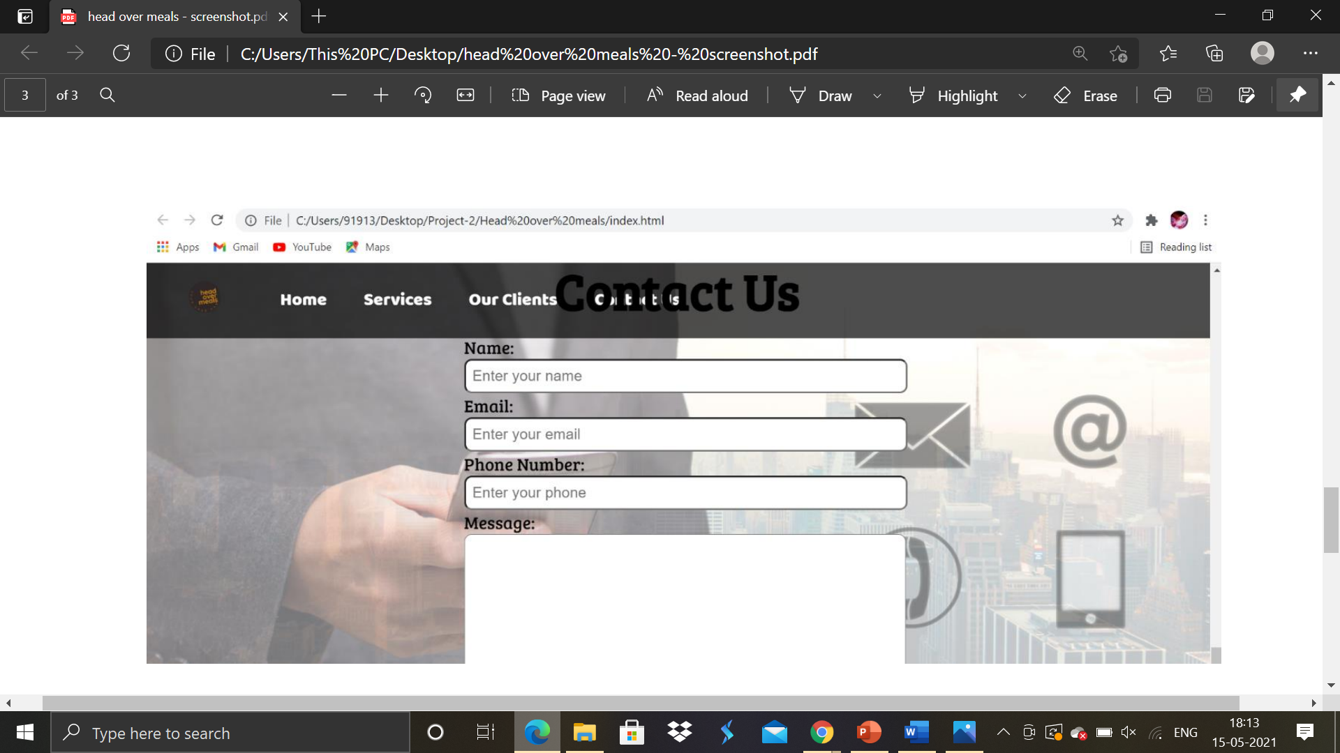

Slide 17
REFERENCES
References:
http://www.w3schools.com/
http://www.googlefonts.com/
Google
YouTube (http://www.youtube.com/)
GitHub

Slide 18
THANKYOU

